Slide 1


Slide 2
HANDLING WITH IMBALANCED DATA

Slide 3




TEAM PRESENTATION
Hoang Phu Main speaker
K20 CS - Big Data Club
Phuoc Minh Collaborator
K20 CS - Big Data Club
Hung Thinh Collaborator
K20 CS - Big Data Club
Quang Khanh Collaborator
K20 CS - Big Data Club

Slide 4
ROADMAP
Introduction to Imbalanced Data
Methods for Imbalanced data preprocessing
Lab and revision
1
3
5
2
4
6
Metrics to evaluate result of a model
Effective models with imbalanced data problem
Kahoot and revision

Slide 5
Introduction to Imbalanced data
1

Slide 6
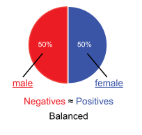
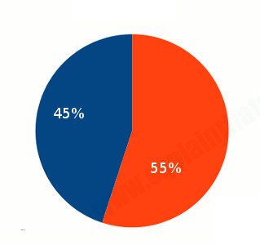
What is balanced data
Number of each class is the same as the other

Slide 7
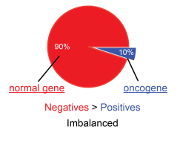
What is Imbalanced Data
Number of one or more classes is significantly higher than others
Majority
Minority

Slide 8
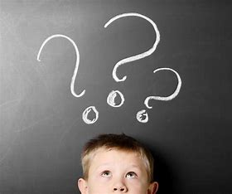
What is Imbalanced Data
Some cases: cancer prediction, bad briefs of an company,...
Are there any way to avoid those cases?

Slide 9
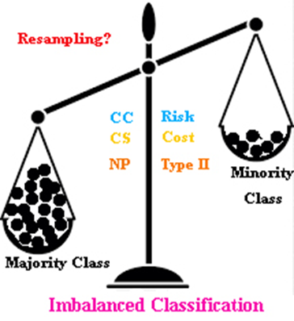
Impact

Slide 10
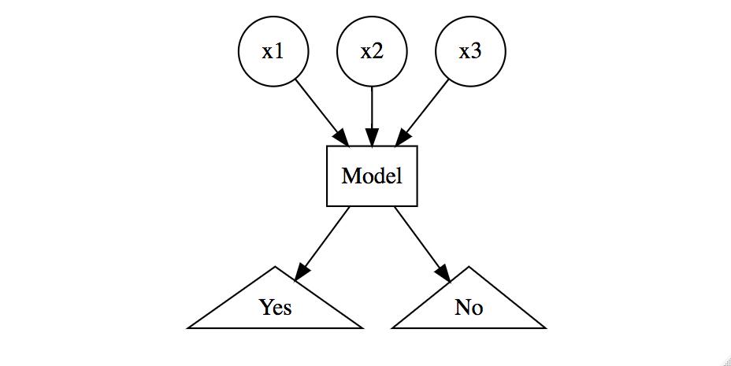
Classification problem

Slide 11

FOR WHICH WE GET MORE EFFICIENT?

Slide 12
Choosing efficient metrics
2

Slide 13
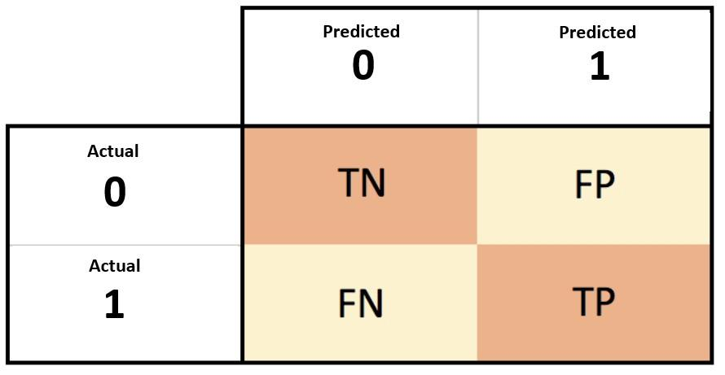
Confusion matrix

Slide 14
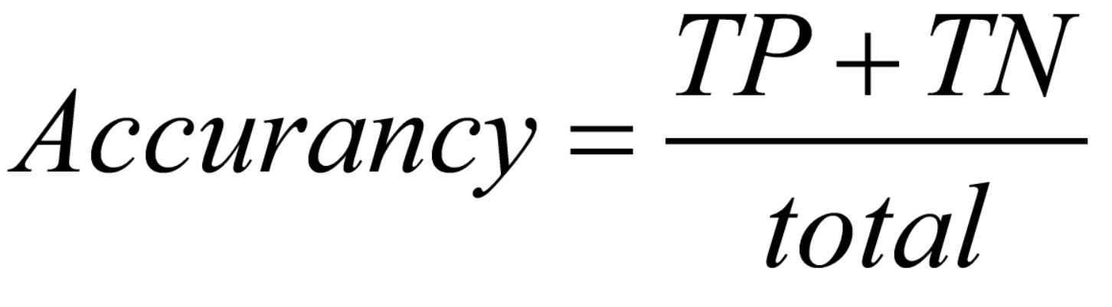
Accuracy
Easy to calculate
Don’t notice to the importance of answer

Slide 15
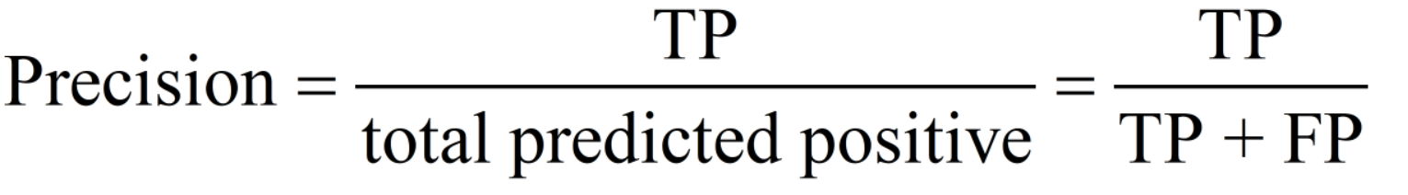
Precision
Question: In answers which predicted positive, how many answers is really true?

Slide 16
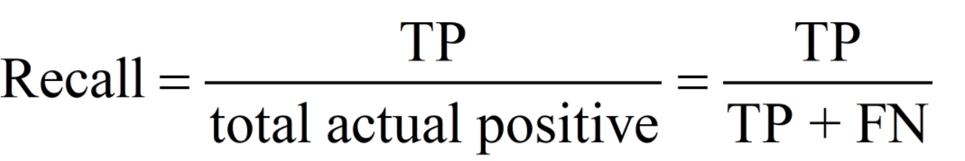
Recall
Question: Rate of positive cases on all samples of positive group?

Slide 17
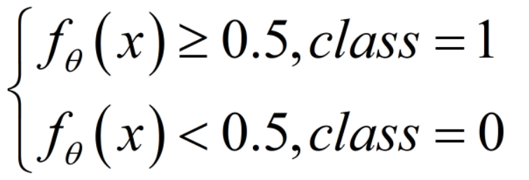
Trade off between precision and recall
Question: How to determine a prediction belongs to which class?

Slide 18
Trade off between precision and recall
Problem: Is there any relationship between precision and recall?
Answer: Yes!

Slide 19
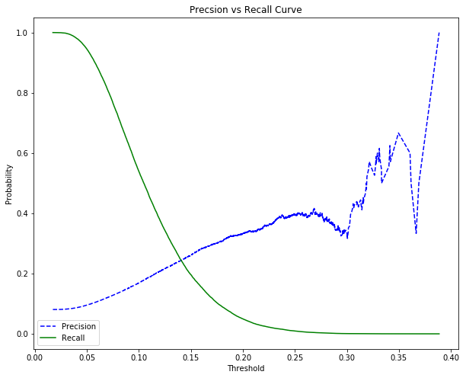

Slide 20
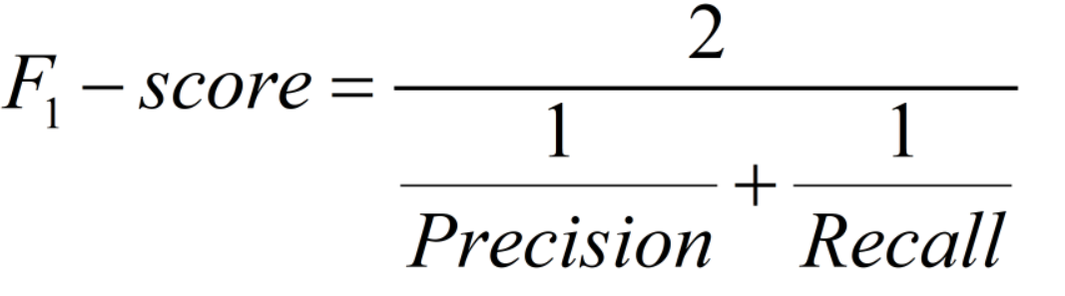
F1-score
Question: How to balance precision and recall?
Question: Why not average?

Slide 21

Which is better?
Is F1-score better than accuracy?

Slide 22
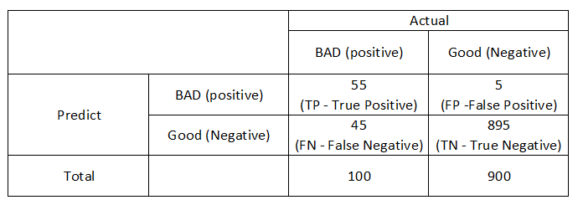
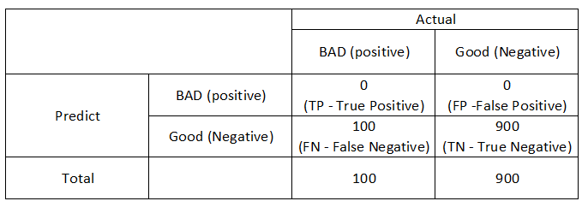
Example
Model 1
Model 2

Slide 23
Receiver Operator Characteristic - ROC
ROC shows the ability to solve the classification problem corresponding to threshold. It contains:
TPR - true positive rate (aka recall)
FPR - false positive rate : Rate of predict a negative event to positive
The smaller FPR, the better result model get.

Slide 24
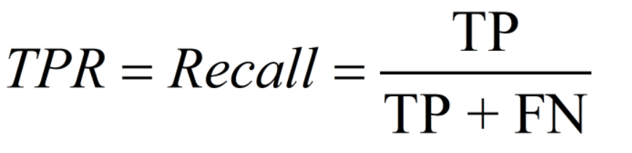
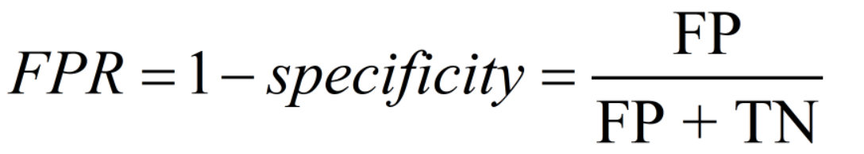
ROC

Slide 25
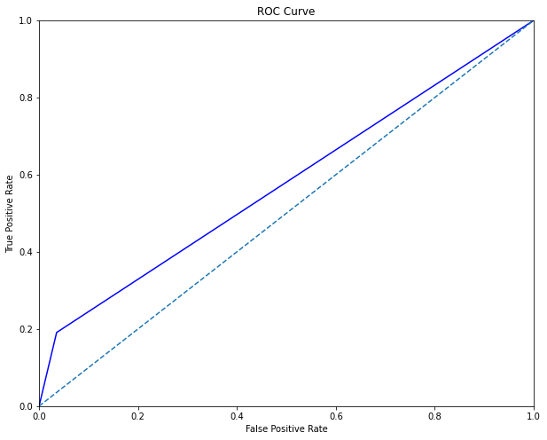
ROC

Slide 26
AUC - Area Under Curve
AUC is calculated based on the ROC
The area below ROC curve and horizontal lines.
Value in [0,1]
The larger value of AUC, the more exactly we have
When ROC and lines between (0,0) and (1,1) is the same, we have a random model

Slide 27
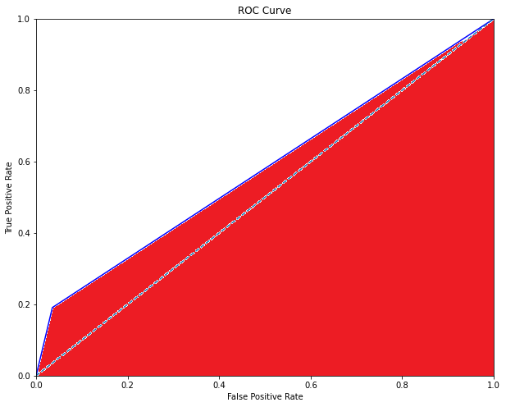
AUC - Area Under Curve

Slide 28
PREPROCESSING WITH IMBALANCED DATA
3

Slide 29
OVERVIEW
Undersampling
Oversampling

Slide 30
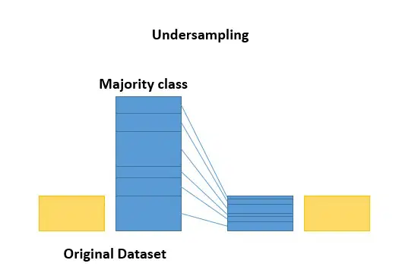
UNDERSAMPLING
Deleting samples from the majority class
Random Undersampling
Near Miss Undersampling

Slide 31
RANDOM UNDERSAMPLING
Random Undersampling involves randomly selecting samples from the majority class to delete from the training dataset.
This can potentially lead to the loss of information

Slide 32
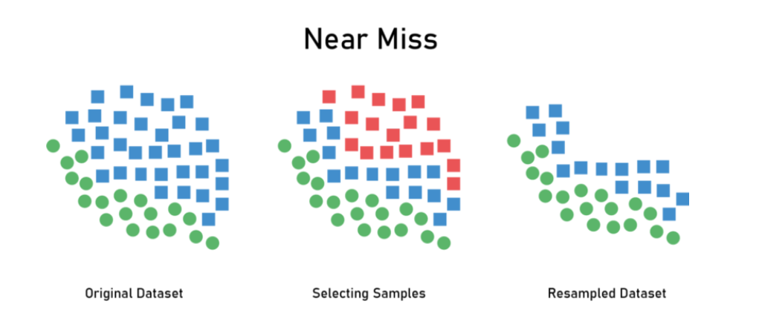
NEAR MISS UNDERSAMPLING
Attacking the issue of potential information loss
Selecting sample based on the distance of majority class sample to minority class samples

Slide 33
NEAR MISS UNDERSAMPLING
Near Miss-1 It selects samples of the majority class for which average distances to the three closest instances of the minority class is smallest.
Near Miss-2 It selects samples of the majority class for which average distances to the three farthest instances of the minority class is smallest.
Near Miss-3 picks a given number of the closest samples of the majority class for each sample of the minority class.

Slide 34
PROS AND CONS
Pros
Less storage
Improve runtime
Cons
Lose potentially important data
The sample of the majority class chosen could be biased

Slide 35
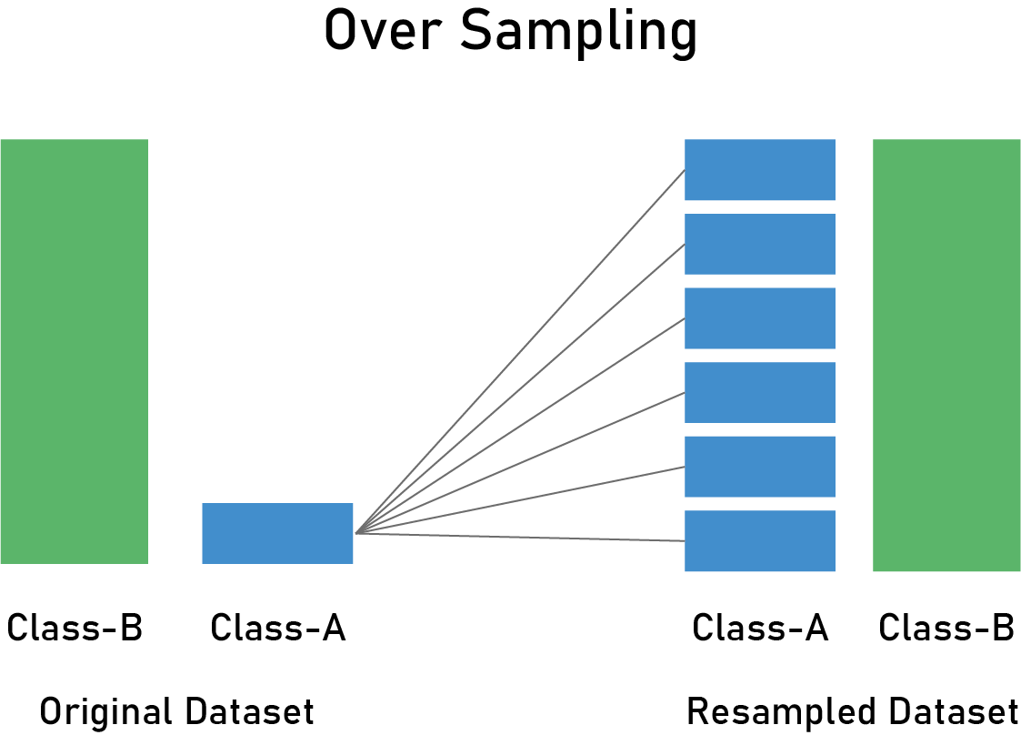
OVERSAMPLING
Duplicating samples from the minority class
Random Oversampling
SMOTE

Slide 36
RANDOM OVERSAMPLING
Random Oversampling involves randomly duplicating samples from the minority class and adding them to the training dataset.
This can cause affected algorithms to overfit the minority class

Slide 37
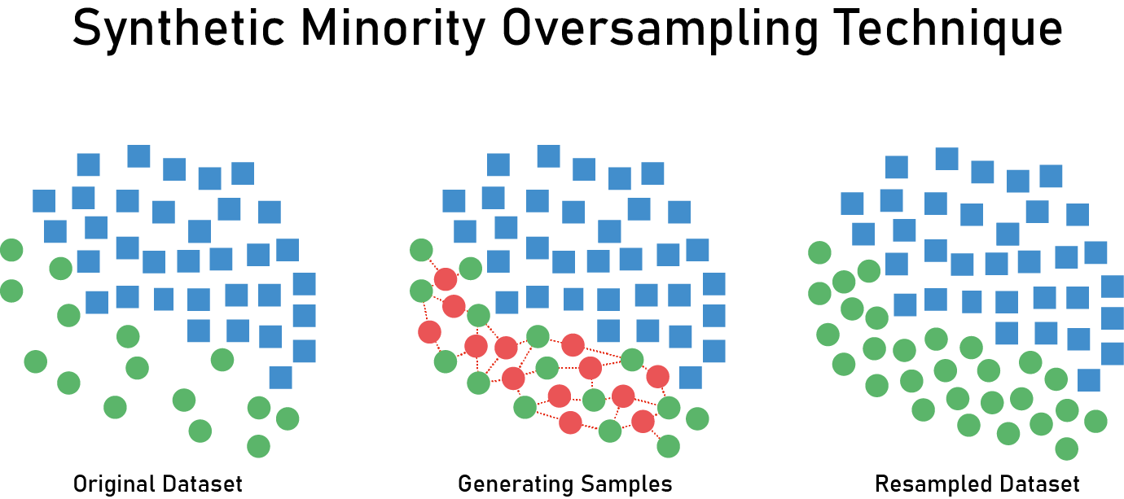
SMOTE
SMOTE = Synthetic Minority Oversampling Technique
This is a type of data augmentation

Slide 38
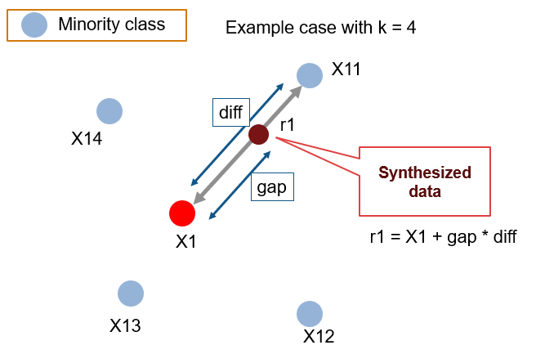

Slide 39
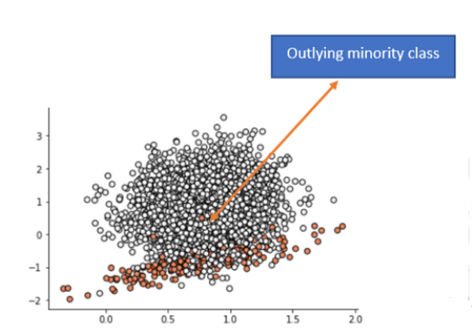
WHAT IF?

Slide 40
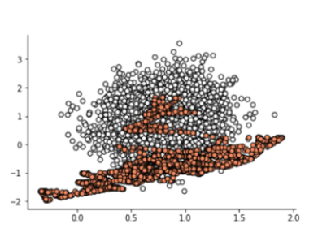
WHAT IF?

Slide 41
OVER OR UNDER?

Slide 42
MODEL EXPERIMENT
4
Model Selection for Imbalance dataset

Slide 43
OVERVIEW
Decision Tree
Model selection
Bagging
Stacking
Boosting

Slide 44
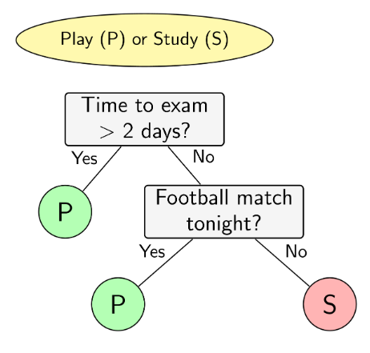
DECISION
TREE
“Basic supervised learning method used for classification and regression”

Slide 45
DEFINITION
A Decision Tree is a supervised Machine learning algorithm. It is used in both classification and regression algorithms.
Decision Trees usually implement exactly the human thinking ability while making a decision, so it is easy to understand.

Slide 46
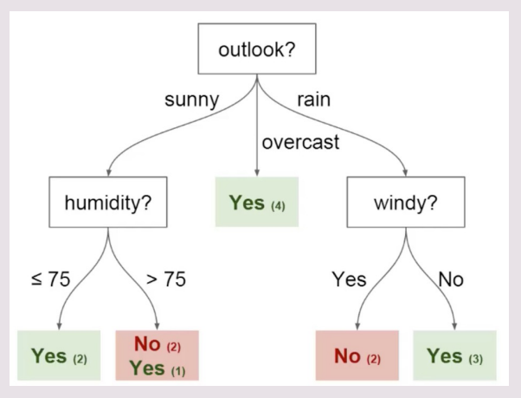
COMPONENT
Root: first split takes place
Leaves: These are the terminal nodes that predict the outcome
Nodes: where the tree splits according to the value of some attribute/feature
Edges: directs the outcome of a split to the next node

Slide 47
HOW TO BUILD
The main thing is to select the best attribute from the total features list of the dataset for the root node as well as for sub-nodes
Some method:
Information Gain (ID3)
Gini

Slide 48
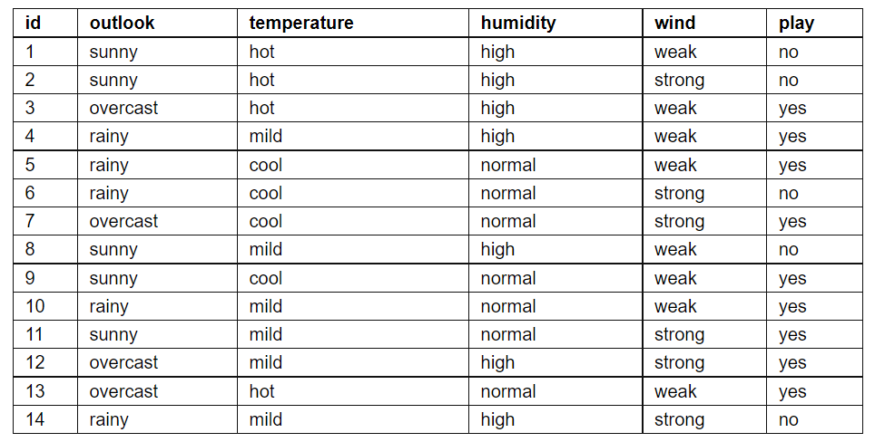
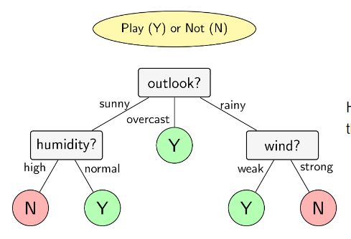
Build-tree ID3
Dataset
Decision-Tree
Example

Slide 49
DECISION-TREE HANDLE OVERFITTING
Early Stopping:
Build the tree to a allowed depth (= max_depth) then stop.
If the total number of leaf nodes exceeds a certain threshold, stop
If that node has a number of elements less than a certain threshold, then we stop building the tree at that node
…………

Slide 50
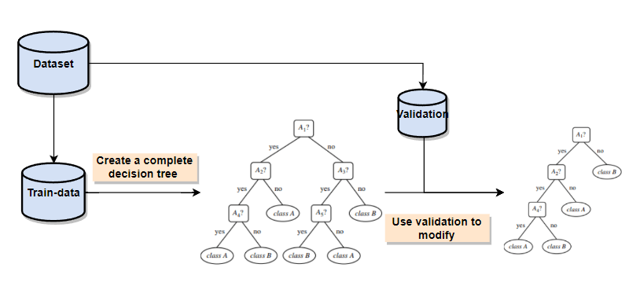
DECISION-TREE HANDLE (Pruning)
Pre-pruning:
There is no need to use the entire dataset to build.
Or each node, we will choose a certain number of features to build,
or limit the number of its children that can be built.
Post-pruning:

Slide 51
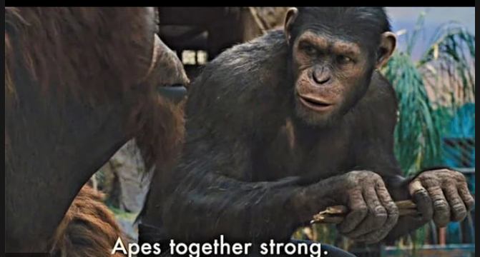
ENSEMBLE LEARNING
“ ĐOÀN KẾT LÀ SỨC MẠNH”

Slide 52
ENSEMBLE LEARNING
Definition
Construction
Ensemble methods is a machine learning technique that combines several base models in order to produce one optimal predictive model
Some weak ML models can be mentioned such as: SVM, Linear Regression, Logistic Regression, Decision Tree,... In this problem, we mainly focus on Decision Tree model.

Slide 53
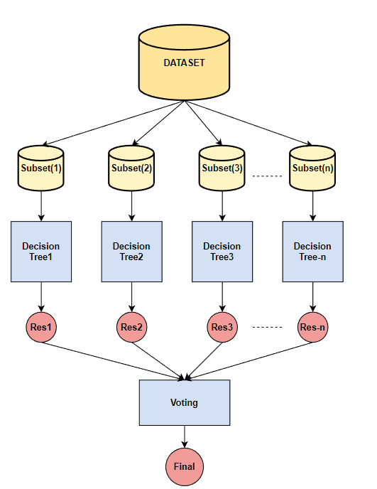
BAGGING
Algorithm
Step 1: create n bag with some random and replacement.
Step 2: create n weak models and train independently on different bags.
Step 3: for each result from the models, vote to choose the best one.

Slide 54
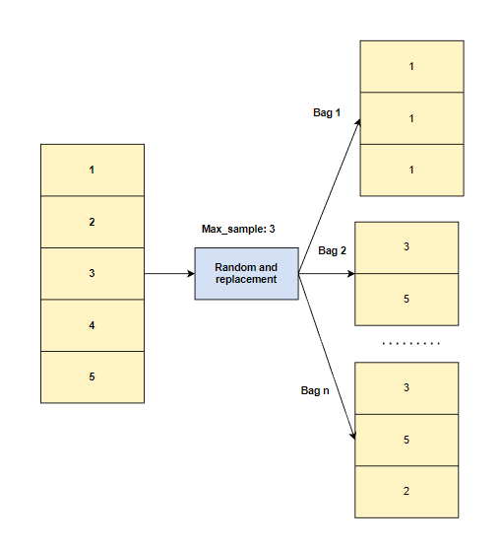
BAGGING
Property
Parameters to generate the bags: max_samples, max_features
Training strategy: Parallel
Decision Tree Model: Every step of this node, choose all feature to split, overfit dataset and no pruning
=> High variance

Slide 55
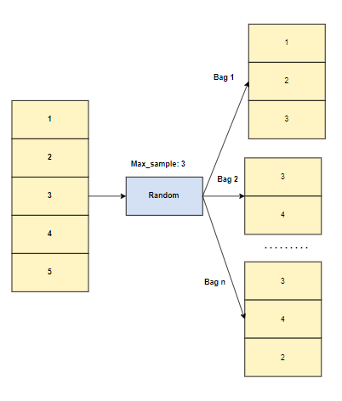
RANDOM FOREST
Property
Idea to the same bagging: but handle high variance
Parameters to control model:
N_estimators, Max_features
Training strategy: Parallel
Decision Tree Model: Every step of this node, choose some feature and split them, pruning and early-stopping

Slide 56
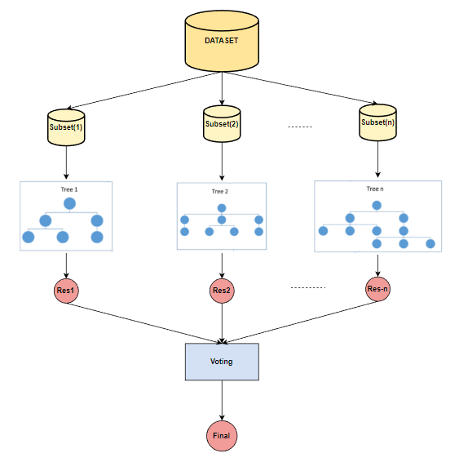
RANDOM FOREST

Slide 57
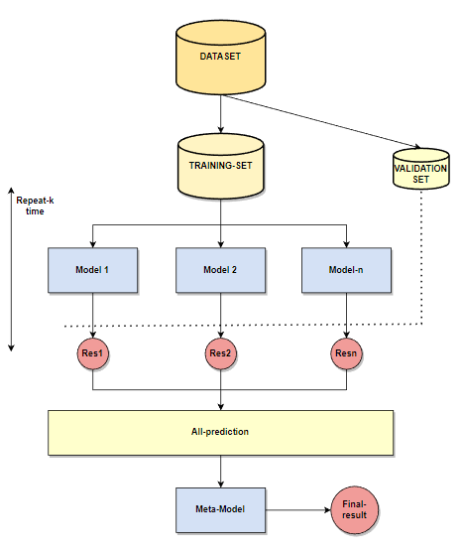
STACKING LEARNING
Algorithm (To minimize error in training)
Step 1: Use all dataset or split train and validation dataset
Step 2: create n weak models (different), give all training-set to all model
Step 3: Repeat k-times training
Step 4: aggregation prediction to new “dataset” and use for meta-model to get final result

Slide 58
STACKING LEARNING
Property
High Result
Training strategy: parallel
Problem: overfitting, sometimes model is not suitable for data set

Slide 59
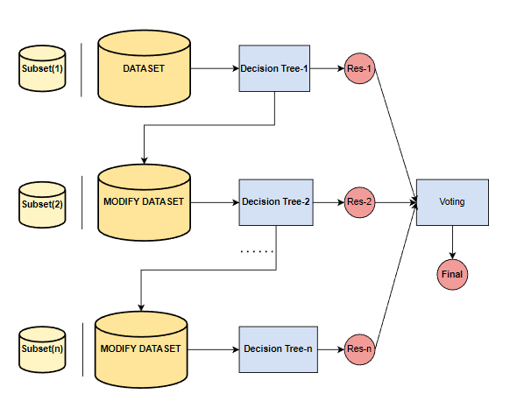
BOOSTING
Algorithm (To minimize error in training)
Step 1: Use all dataset or create n-subset data for training
Step 2: create n weak models, fitted with a model and then trained sequentially—that is, each model tries to compensate for the weaknesses of its predecessor
Step 3: for each result from the models, vote to choose the best one.

Slide 60
BOOSTING
Property
Parameters to control model:
N_estimators, Max_features
Training strategy: Sequential
Benefit: better learn strategy to get high result but high computational

Slide 61

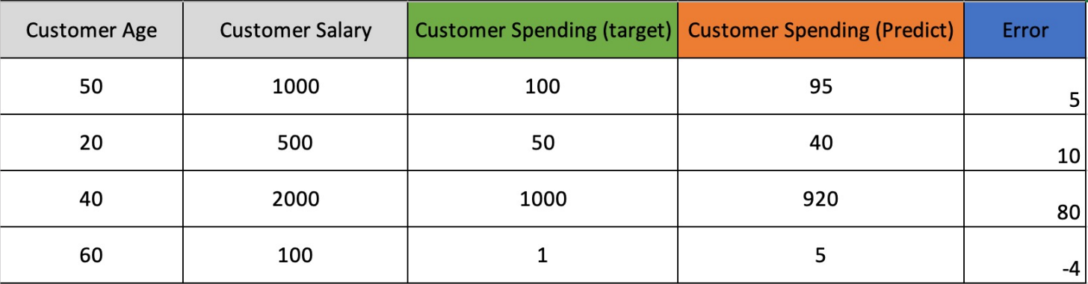
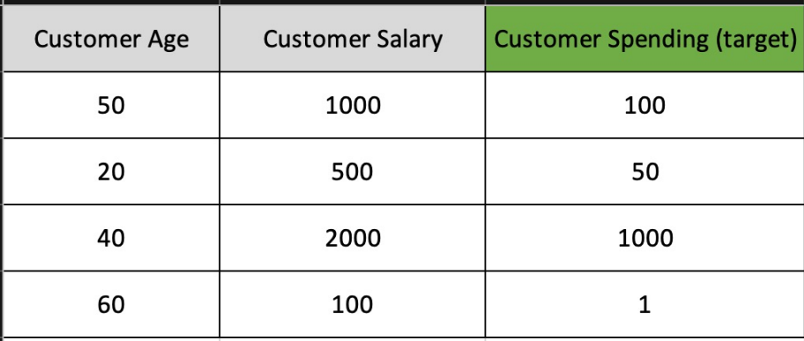
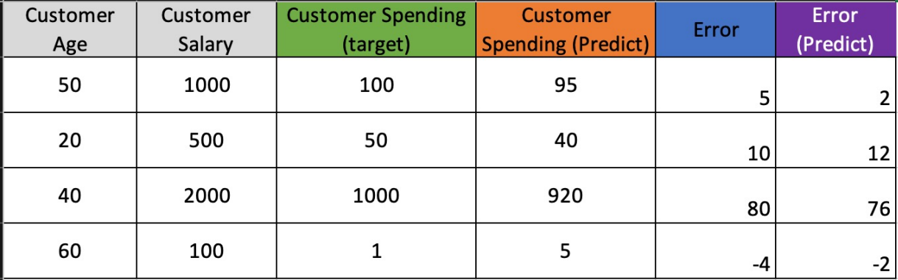
BOOSTING-EXAMPLE
B1: Predict từ model1 và tính error.
B2: Train và predict từ error để điều chỉnh.
B3: Lặp lại quá trình tính error trên đến khi: đạt giới hạn số lượng cây hoặc sai số error nhỏ.

Slide 62
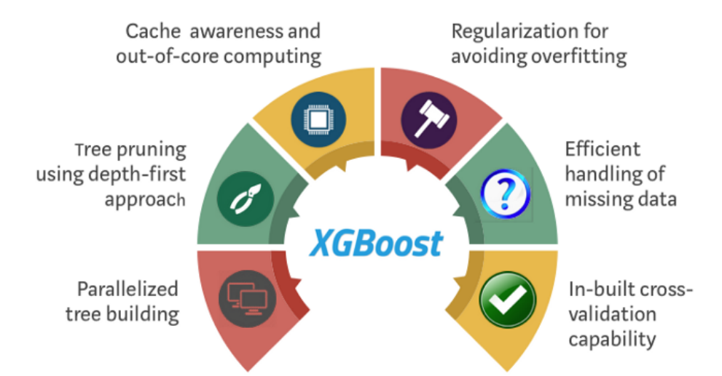
XGBOOST

Slide 63
Reference
5
https://phamdinhkhanh.github.io/2020/08/13/ModelMetric.html
https://www.youtube.com/watch?v=_fe7JOBGbuU&t=2222s
https://machinelearningcoban.com/2018/01/14/id3/

Slide 64

Thanks for listening!!!

